Slide 1
Would like to thank our sponsors

Slide 2
Gold Sponsor

Slide 3
Bronze Sponsor

Slide 4
Bronze Sponsor

Slide 5
Bronze Sponsor

Slide 6
Table Sponsors
ACC Senior Services
Asian Pacific Islander American Public Affairs Association (APAPA)
Asian Peace Officers Association (APOA)
Asian Resources

Slide 7
Table Sponsors
Curtis Ishii
My Sister’s House
Organization of Chinese Americans (OCA) Sacramento
Rhonda Basarich
Transformation Management Group

Slide 8
Table Sponsors
Friends of
California Department of General Services
California Correctional Health Care Services
California Department of Rehabilitation

Slide 9
Individual/Organization
Scholarship Sponsors
Asian Pacific State Employees Association (APSEA) Foundation
APSEA of Sacramento
Chinese American Council of Sacramento (CACS)
SEIU 1000
Verizon
Woo Family

Slide 10
Prior Scholarship Recipients
2015 Recipient

Slide 11
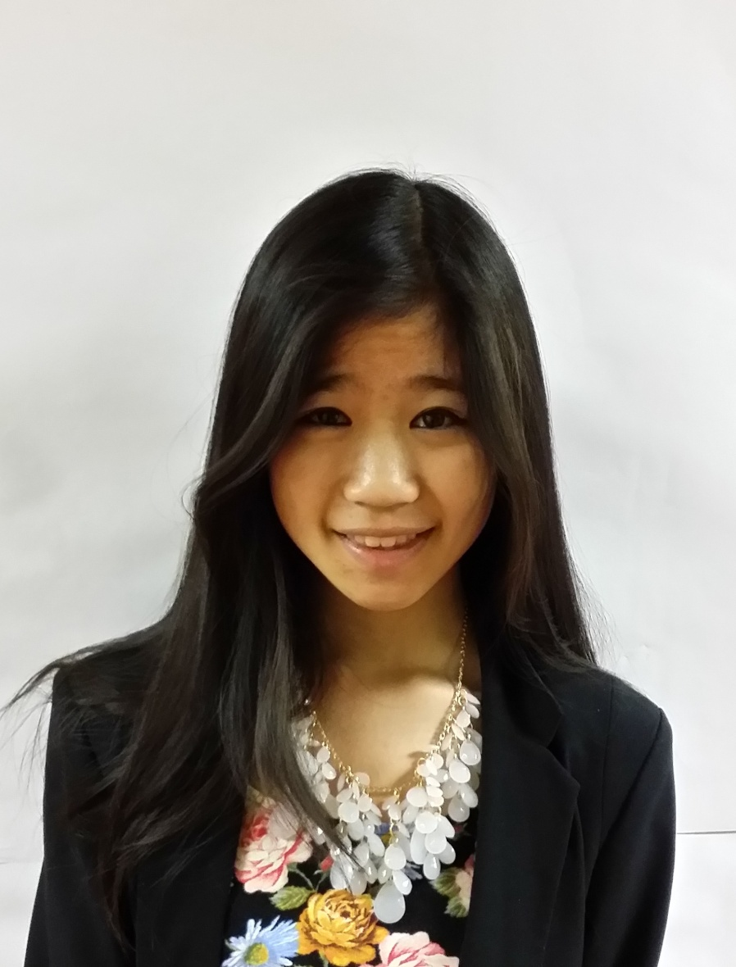
Prior Scholarship Recipients
2015 Recipient

Slide 12
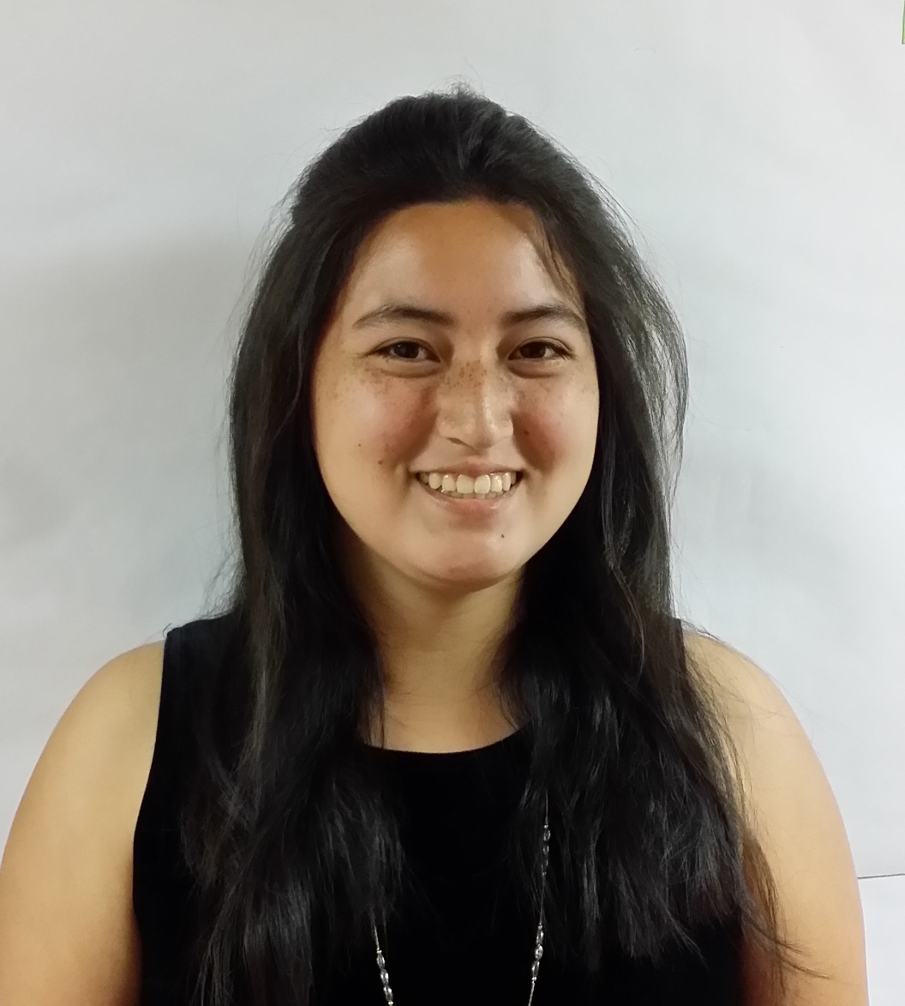
Prior Scholarship Recipients
2015 Recipient

Slide 13
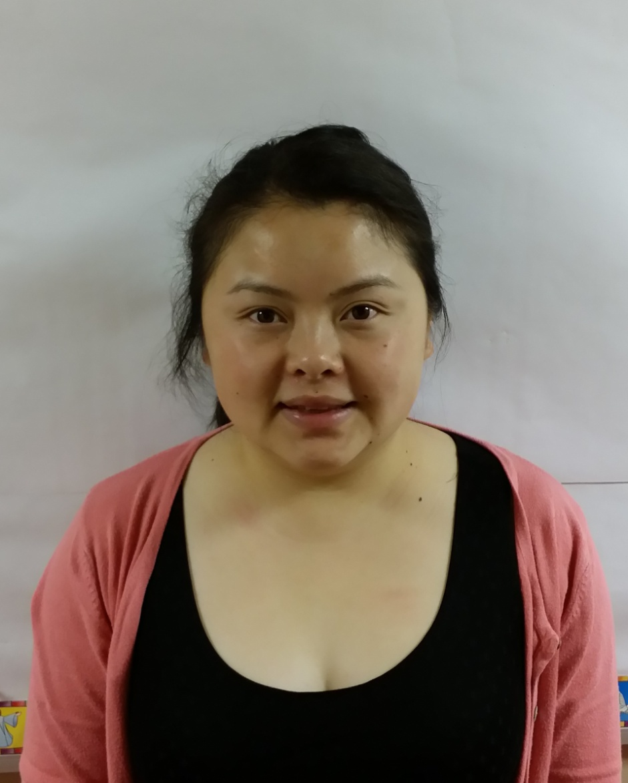
Prior Scholarship Recipients
2015 Recipient

Slide 14
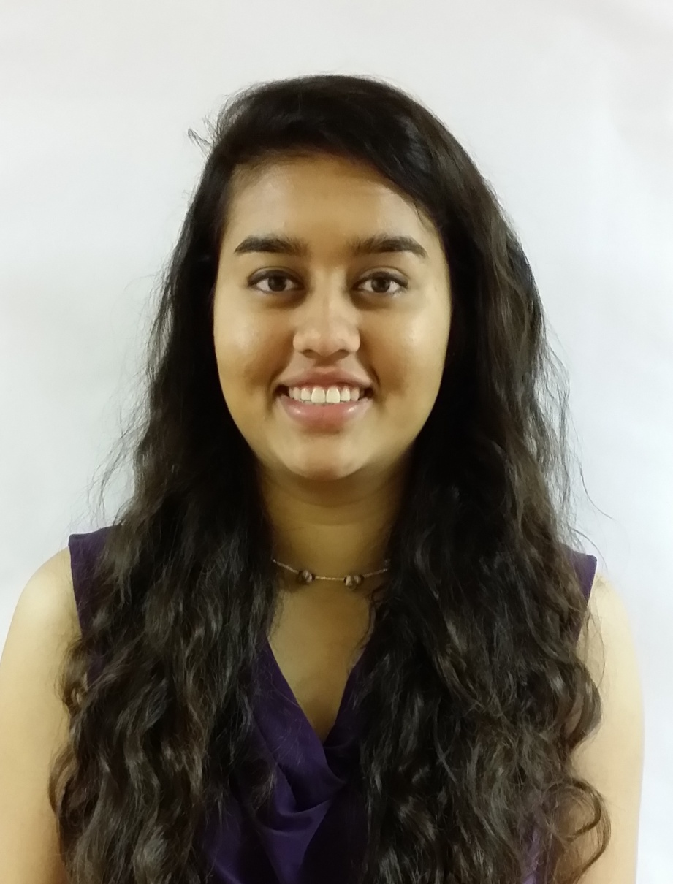
Prior Scholarship Recipients
2015 Recipient

Slide 15
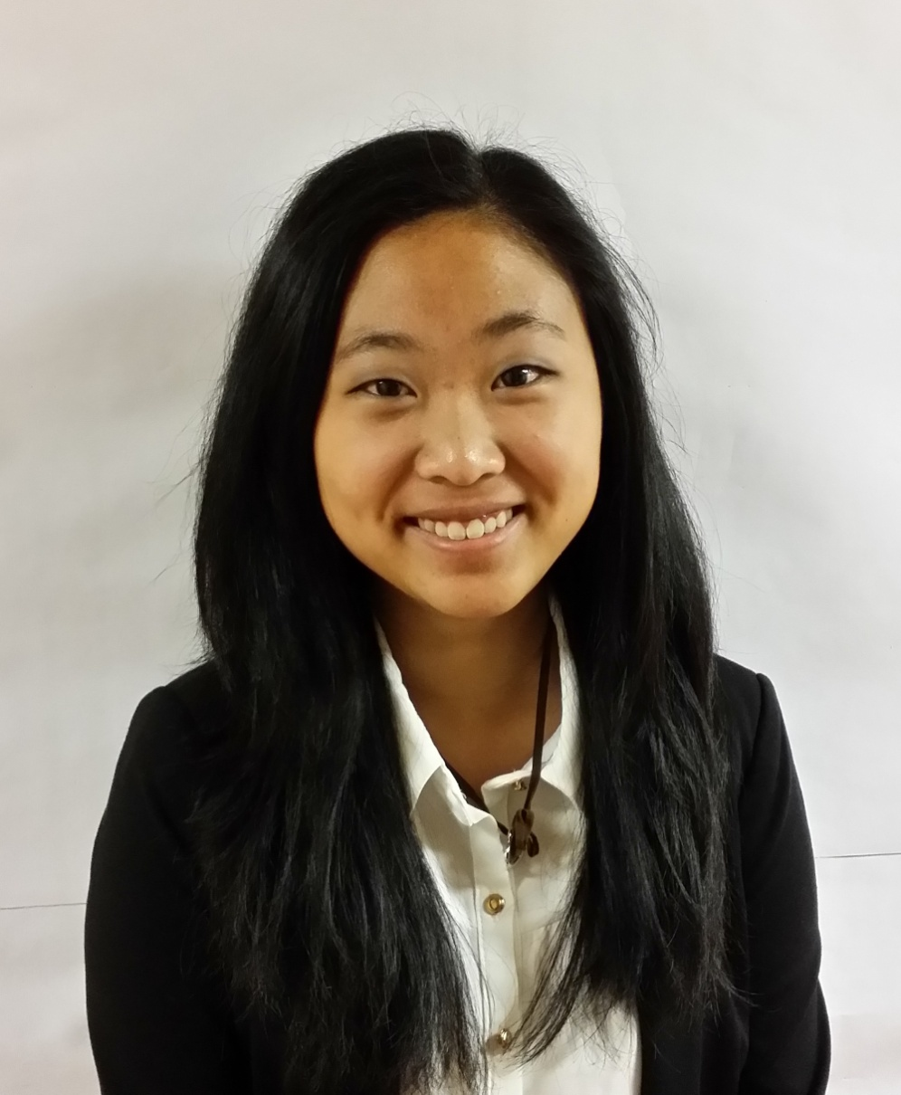
Prior Scholarship Recipients
2015 Recipient

Slide 16
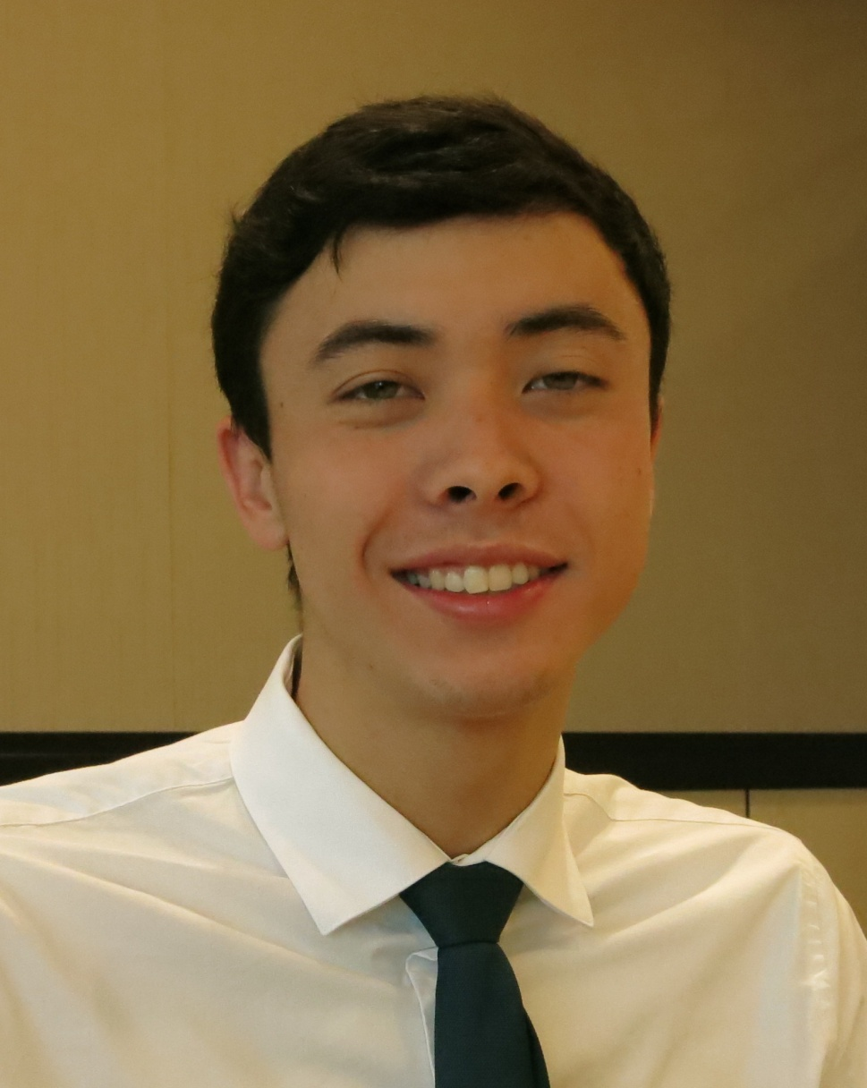
Prior Scholarship Recipients
2014 Recipient

Slide 17
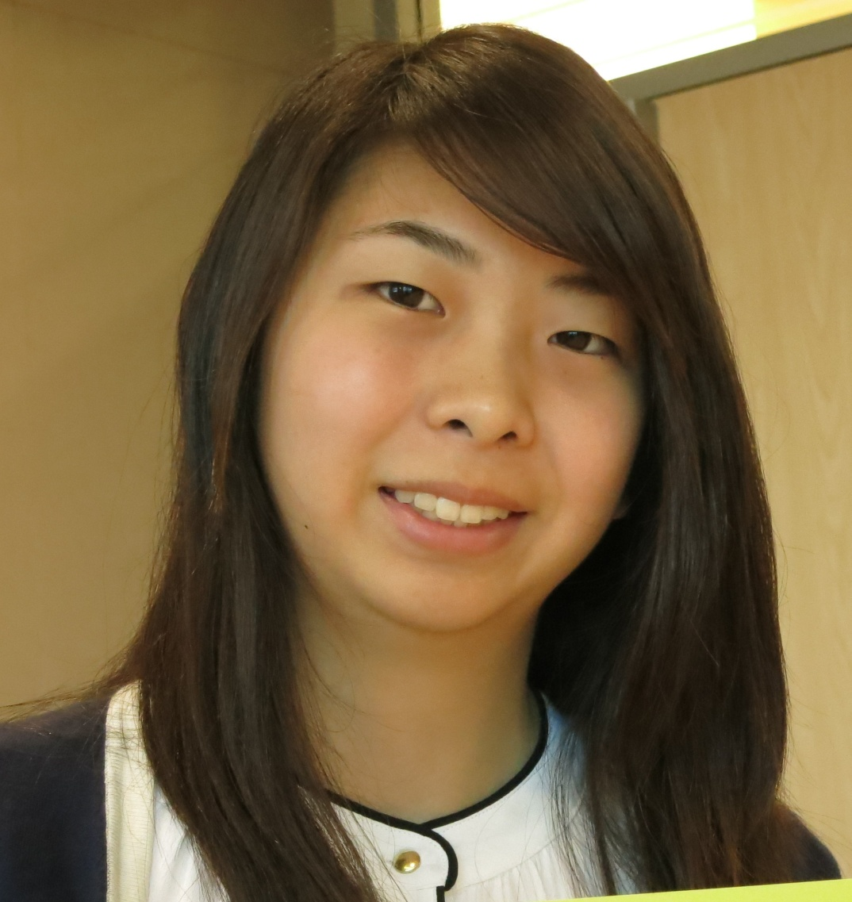
Prior Scholarship Recipients
2014 Recipient

Slide 18
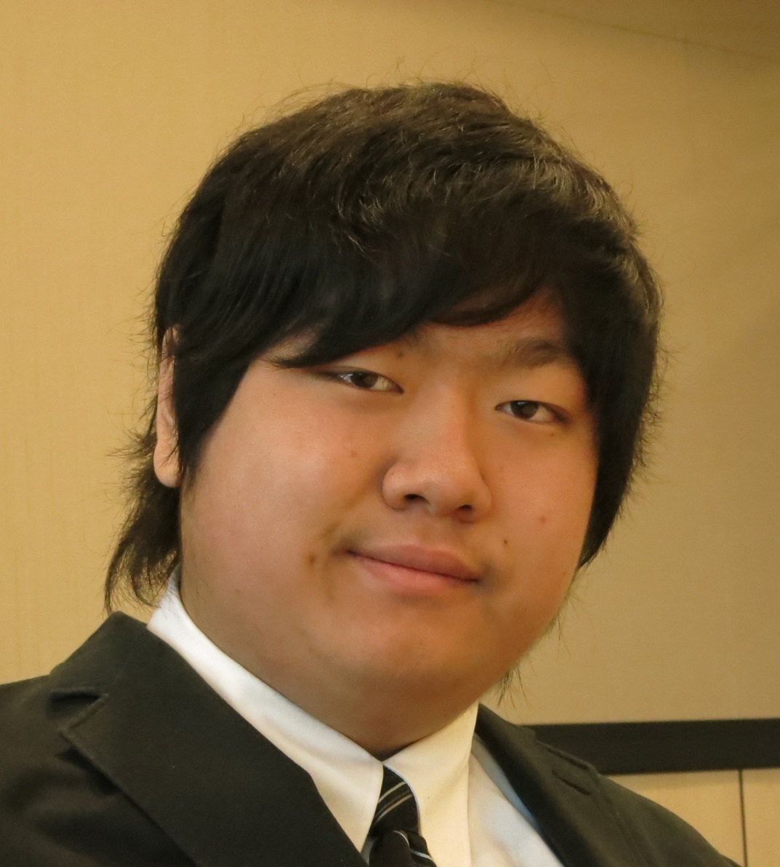
Prior Scholarship Recipients
2014 Recipient

Slide 19
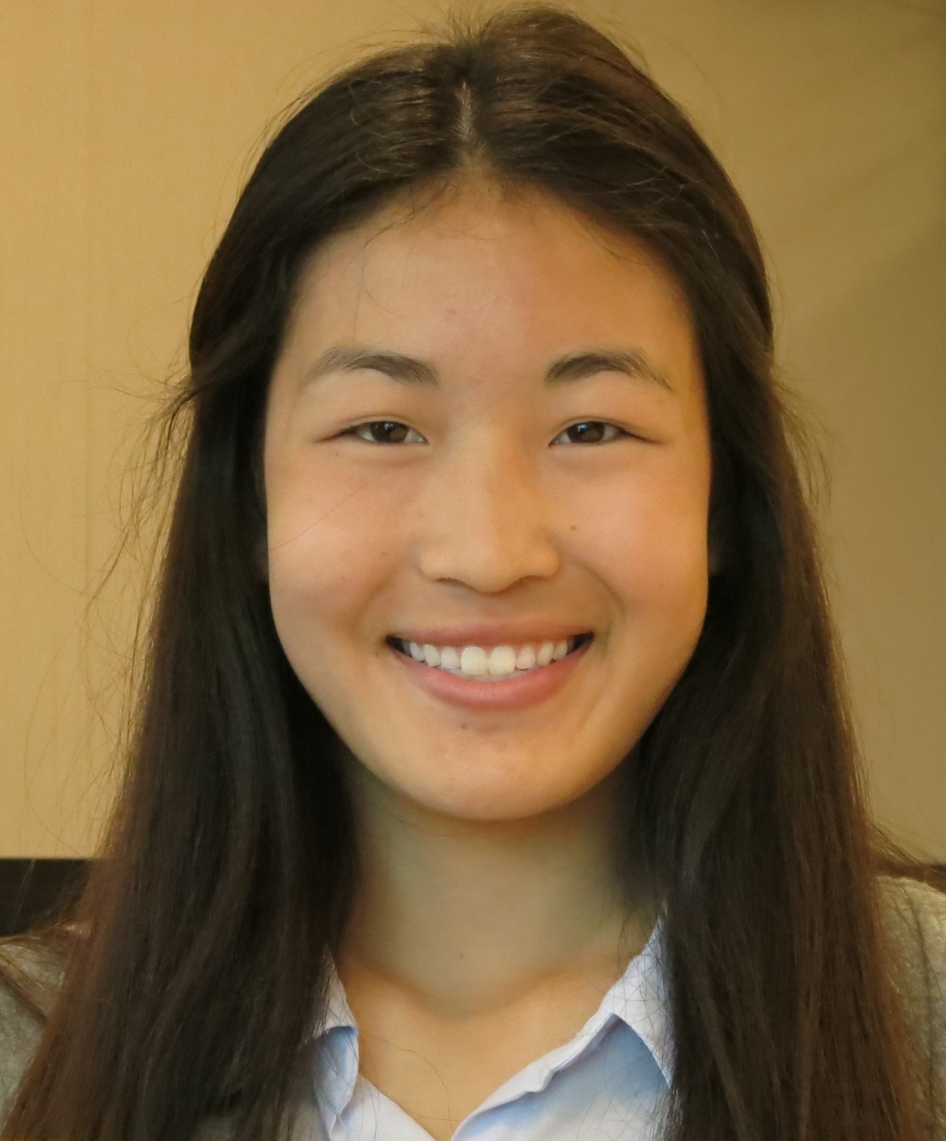
Prior Scholarship Recipients
2014 Recipient

Slide 20
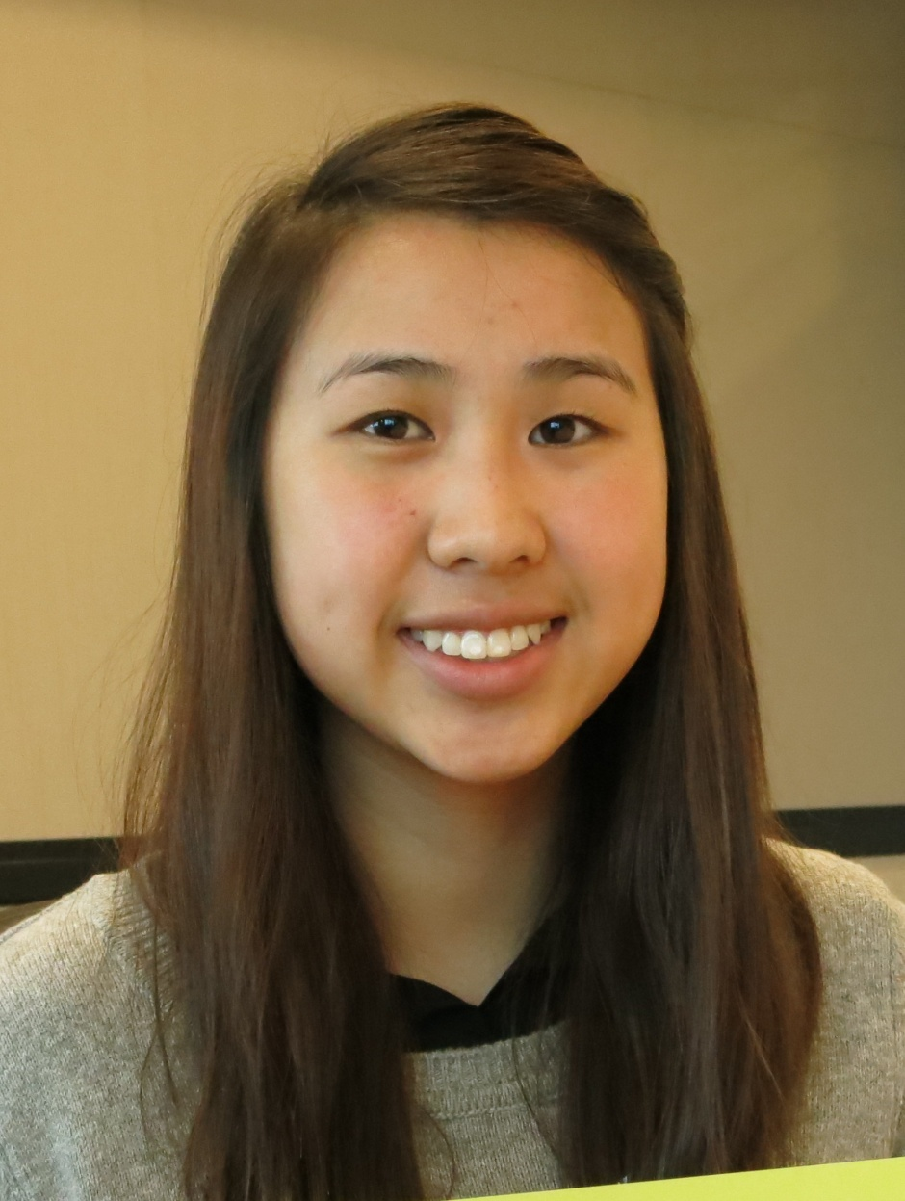
Prior Scholarship Recipients
2014 Recipient

Slide 21
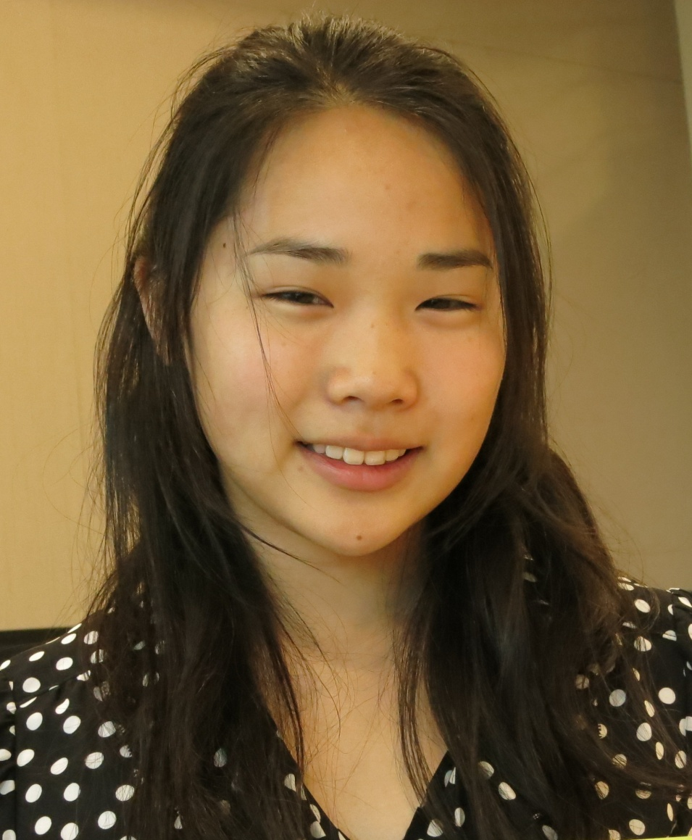
Prior Scholarship Recipients
2014 Recipient

Slide 22
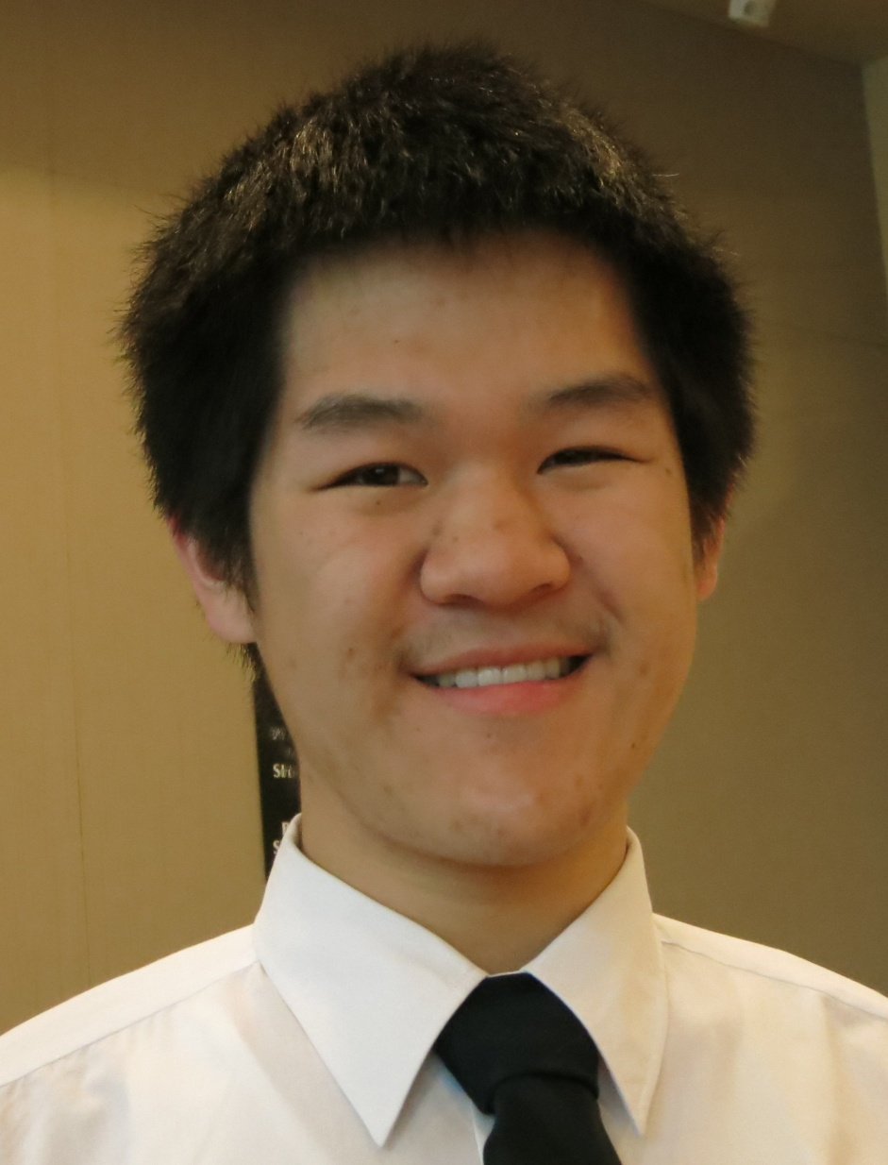
Prior Scholarship Recipients
2014 Recipient

Slide 23
Prior Scholarship Recipients
2011 Recipient

